Slide 1
Dimensionality Reduction and Anomaly prediction deep dive
Session7
Arunkarthik T

Slide 2
Agenda
Dimensionality Reduction: Simplify complex data to pinpoint the most critical aspects.
Anomaly Detection: Identify problems early for proactive solutions and preventative maintenance.
Notes:
https://www.linkedin.com/pulse/100-open-source-big-data-ml-architecture-papers-sequel-anil-madan

Slide 3
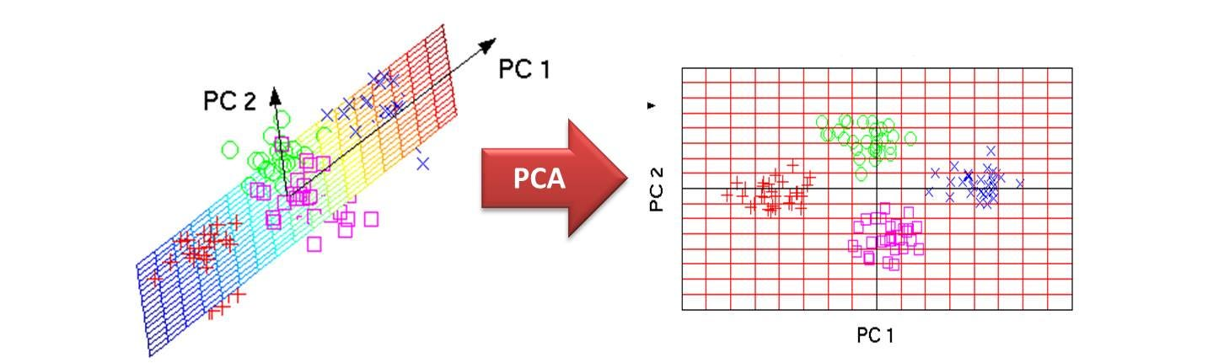
Introduction
Many Machine Learning problems involve thousands or even millions of features for each training instance.
Not only do all these features make training extremely slow, but they can also make it much harder to find a good solution, as we will see.
This problem is often referred to as the curse of dimensionality.
Notes:
https://www.linkedin.com/pulse/100-open-source-big-data-ml-architecture-papers-sequel-anil-madan

Slide 4
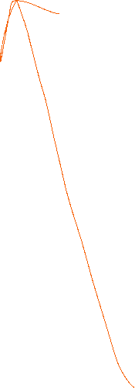







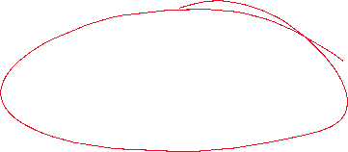



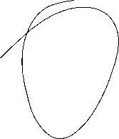
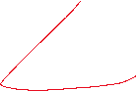
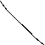
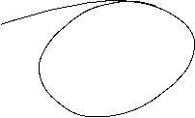

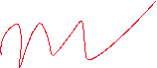
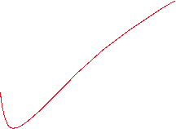
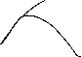

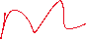



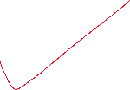

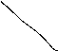




Slide 5

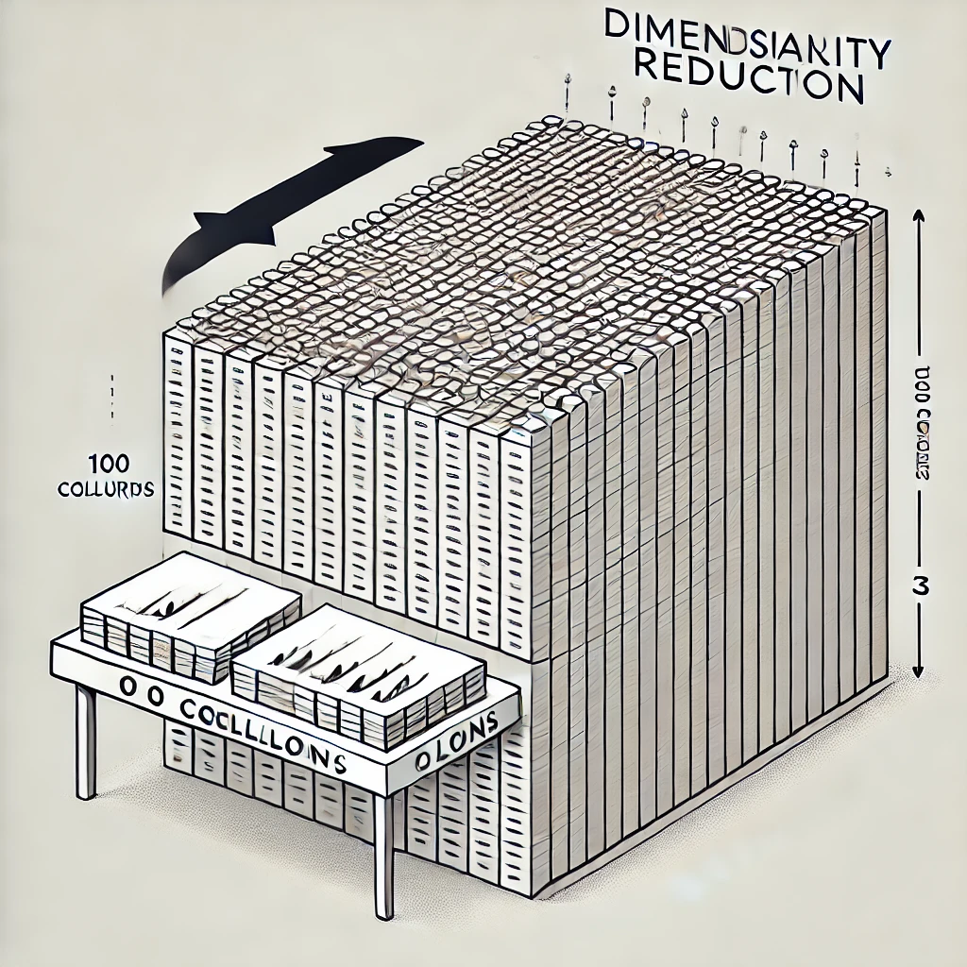
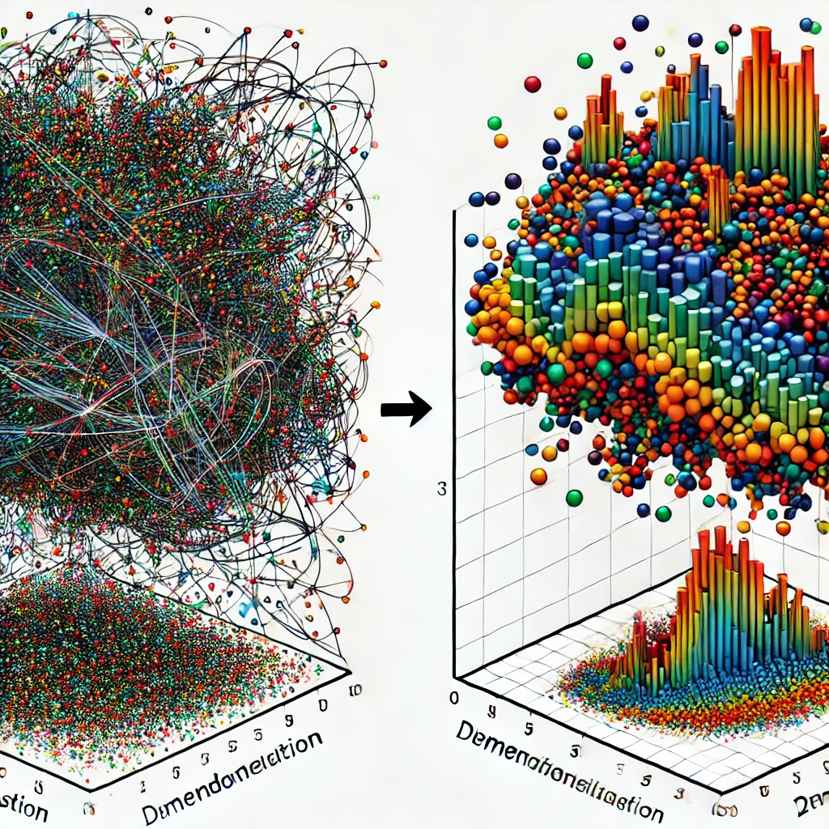
Caution in PCA
Reducing dimensionality can speed up training but may lead to some information loss, just like compressing an image.
This can slightly degrade system performance and make your pipelines more complex.
Before using dimensionality reduction, try training with the original data.
Sometimes, it may improve performance by removing noise, but it generally speeds up training.
Notes:
https://www.linkedin.com/pulse/100-open-source-big-data-ml-architecture-papers-sequel-anil-madan

Slide 6
Advantages in PCA
Dimensionality reduction isn't just for speeding up training; it's also vital for data visualization.
By reducing dimensions to two or three, you can plot high-dimensional data, revealing patterns like clusters.
This helps in gaining insights and effectively communicating findings, especially to non-data scientists, like decision-makers.
In this chapter, we'll explore the curse of dimensionality, learn about high-dimensional spaces, and cover the main approaches to dimensionality reduction: projection and Manifold Learning. We'll also dive into three popular techniques: PCA, Kernel PCA, and LLE.
Notes:
https://www.linkedin.com/pulse/100-open-source-big-data-ml-architecture-papers-sequel-anil-madan

Slide 7
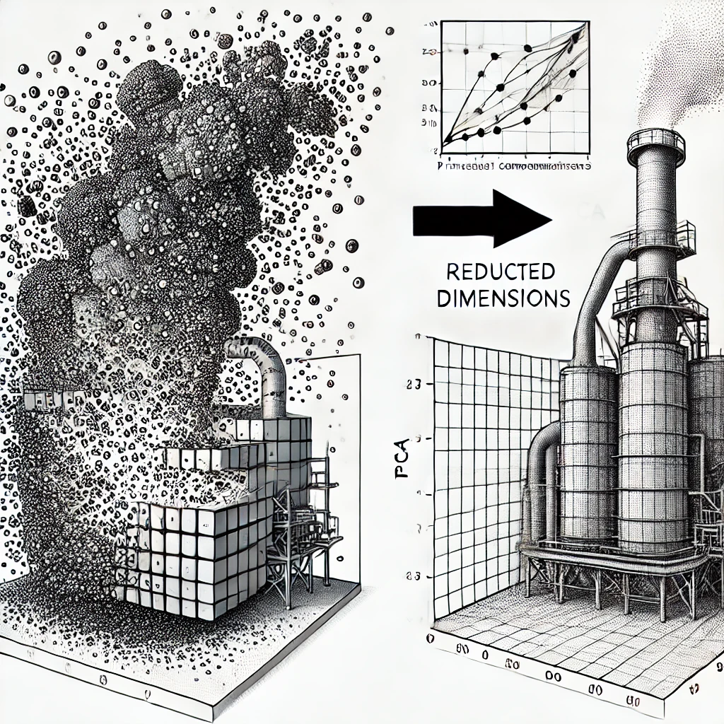
DisAdvantages in PCA
Imagine You Have a Few Features (Low-Dimensional Space):
Example: You start with just two features, like temperature and pressure, to predict silicon content in the furnace.
What Happens: You can easily visualize this in a 2D graph, where each point represents a different furnace condition. The points are close together, making it easier to spot patterns and similarities.
Now, Imagine You Have Many Features (High-Dimensional Space):
Example: Now you have 100 features, including temperature, pressure, raw material quality, and others.
What Happens: In this 100-dimensional space, it’s no longer easy to visualize. The data points (different furnace conditions) are much more spread out, and the distances between points increase significantly.
Notes:
https://www.linkedin.com/pulse/100-open-source-big-data-ml-architecture-papers-sequel-anil-madan

Slide 8
Curse of Dimensionality in Your Blast Furnace:
Data is Sparse:
With so many features, the data points are far apart. For your blast furnace, each operating condition is very different from the others in this high-dimensional space. This makes it harder to find patterns and predict silicon content accurately.
Points Near the Edge:
In high dimensions, most data points end up near the edges of the space. Small changes in input features might make the operating condition seem extreme or unusual for your furnace, leading to less reliable predictions.
Increased Complexity:
With more dimensions, the average distance between points increases, meaning two similar furnace conditions might be very different when considering all 100 features.
Overfitting Risk:
With so many features, your model might try to capture every tiny detail (including noise), leading to overfitting. This means it works well on your training data but poorly on new data.
What Can You Do?
Dimensionality Reduction: You can reduce the number of features to a smaller number (like 3 or 5) that still capture most of the important information. This makes the problem easier to handle and reduces the chance of overfitting.
Notes:
https://www.linkedin.com/pulse/100-open-source-big-data-ml-architecture-papers-sequel-anil-madan

Slide 9
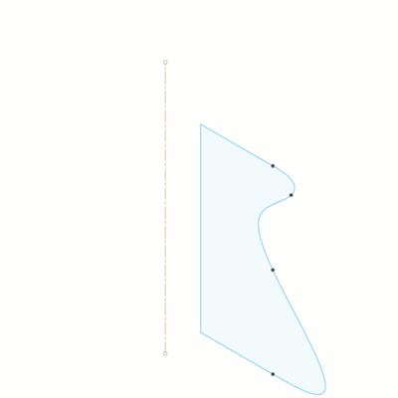
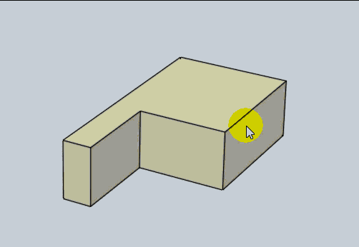
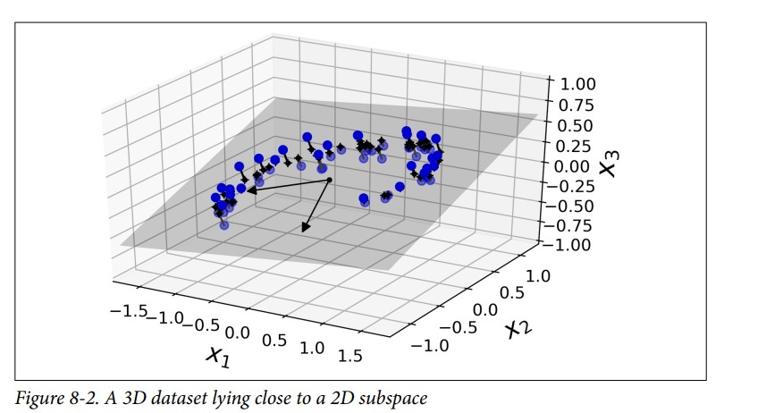
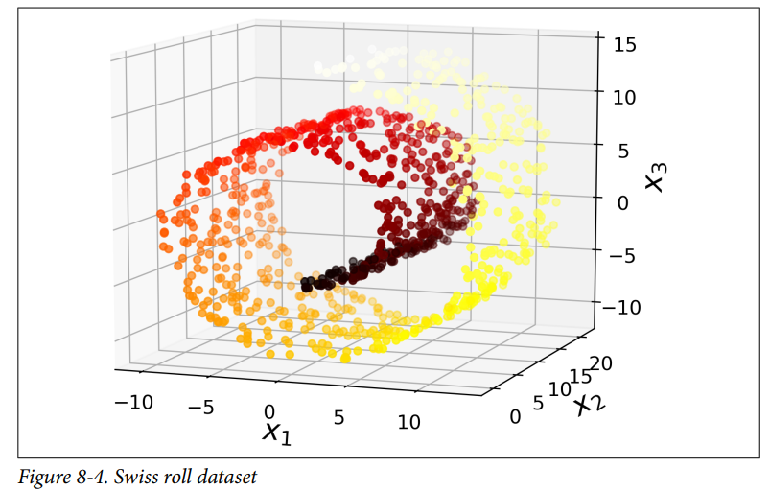
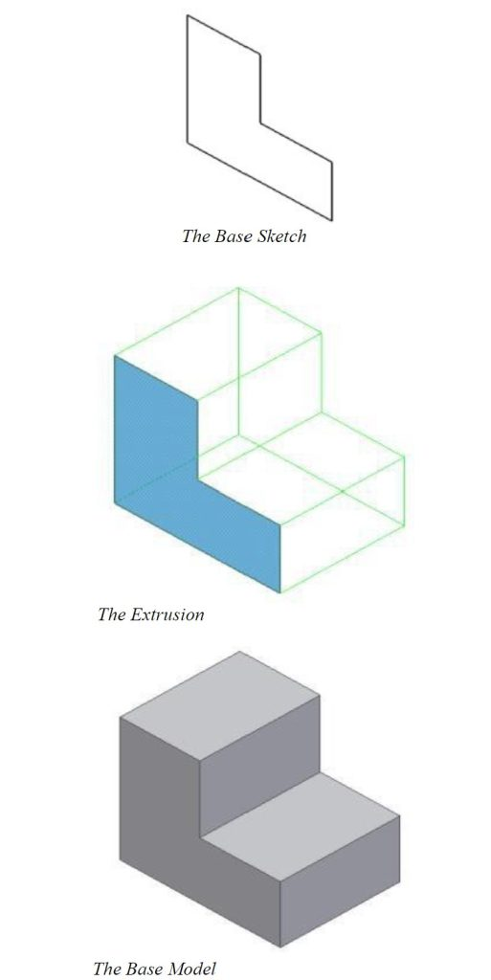
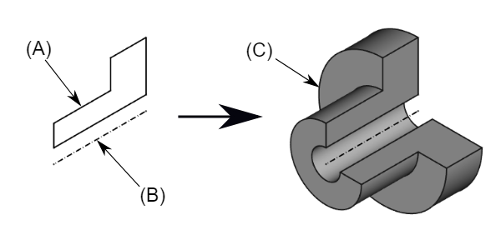
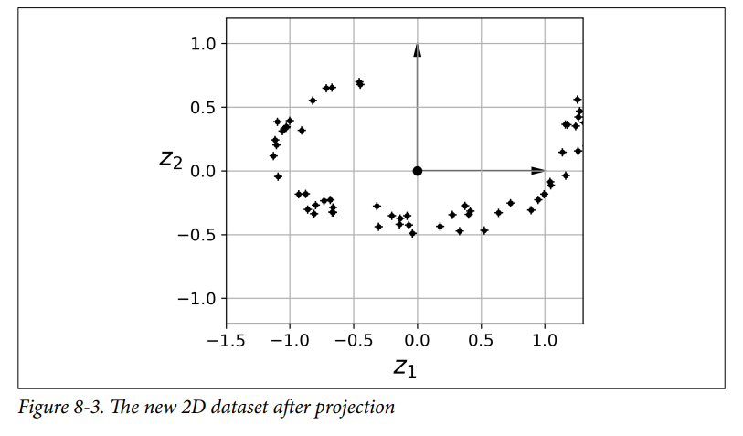
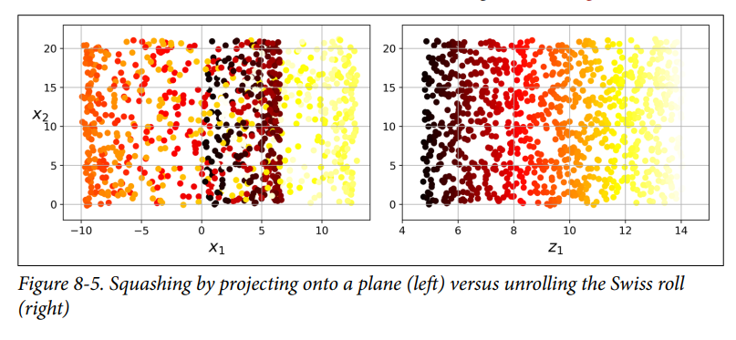

Main Approaches for Dimensionality Reduction
Projection
Swiss Roll
Notes:
https://www.linkedin.com/pulse/100-open-source-big-data-ml-architecture-papers-sequel-anil-madan

Slide 10
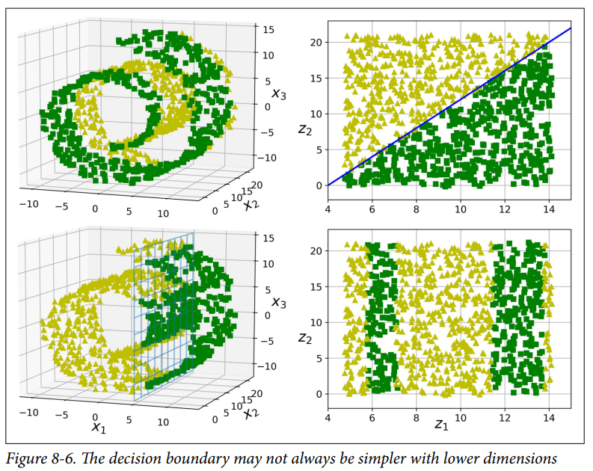
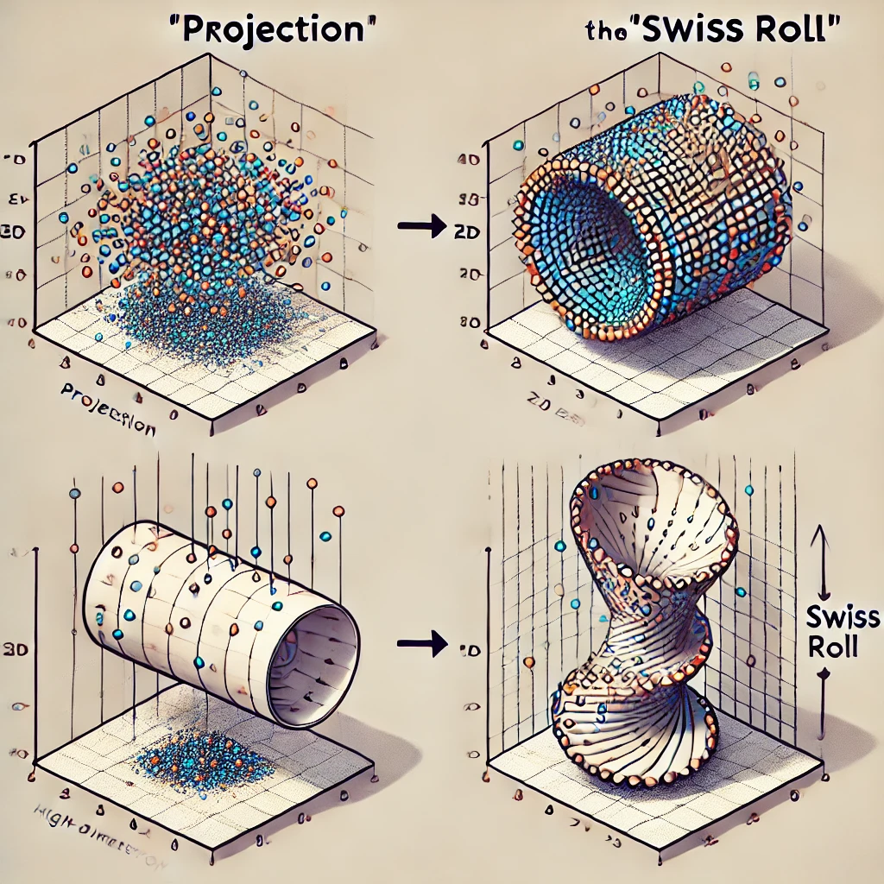
Main Approaches for Dimensionality Reduction
Notes:
https://www.linkedin.com/pulse/100-open-source-big-data-ml-architecture-papers-sequel-anil-madan

Slide 11
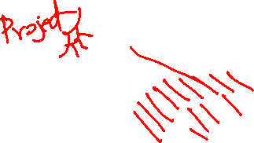
PCA
Principal Component Analysis (PCA) is by far the most popular dimensionality reduc‐ tion algorithm. First it identifies the hyperplane that lies closest to the data, and then it projects the data onto it, just like in Figure 8-2.
Notes:
https://www.linkedin.com/pulse/100-open-source-big-data-ml-architecture-papers-sequel-anil-madan

Slide 12
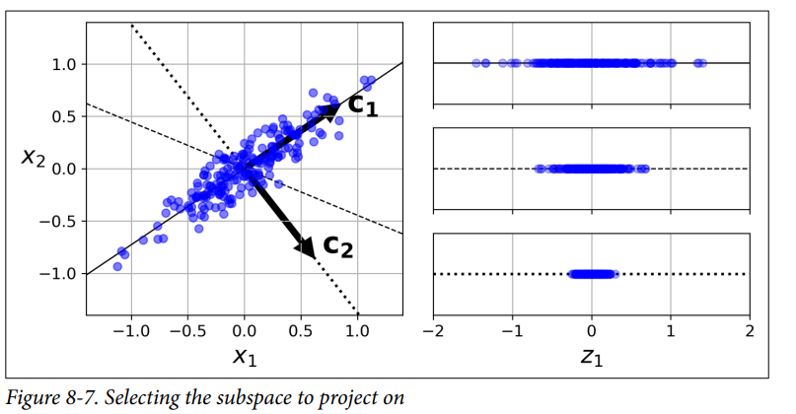
PCA: Preserving the Variance
The image and explanation describe the best axis (or direction) to protect your data when reducing dimensions, like in PCA.
Here's a simple breakdown:
Left Side:
You have a 2D dataset (blue points) with three different possible axes (solid, dashed, and dotted lines).
Right Side:
These show the result of projecting the data onto each axis.
The top projection (solid line) keeps the most variation in the data, meaning it captures the most important information.
The middle projection (dashed line) keeps some information, but not as much.
The bottom projection (dotted line) loses a lot of information; the data is squished into a small range.
Key Point:
Choosing the Best Axis: The best axis for projection is the one that preserves the most variance (spread) in the data, as it captures the most information. This is the idea behind PCA—finding the direction that best represents your data when reducing dimensions.
Notes:
https://www.linkedin.com/pulse/100-open-source-big-data-ml-architecture-papers-sequel-anil-madan

Slide 13
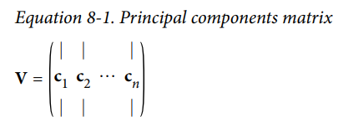
PCA: Principal Components
Principal Components (PCs):
PCA finds the axis (direction) that captures the most variance (spread) in the data. In the first image, this is shown by the solid line (labelled c1 ​).
The first principal component (PC) is the direction the data varies the most. This is where you lose the least information if you project your data onto this axis.
The second PC is orthogonal (at a right angle) to the first and captures the most variance left after accounting for the first PC. In the image, this is represented by the dotted line (labelled c2​).
Principal Component Matrix (Equation 8-1):
The matrix VVV in the equation contains all the principal components (the axes c1,c2​, etc.).
These components are unit vectors (vectors of length 1) that define the directions of maximum variance.
Orthogonal Axes:
In higher dimensions, PCA would find additional orthogonal axes (like a third, fourth, etc.) until it spans all the dimensions of the dataset. Each of these axes captures the remaining variance after the previous PCs.
Notes:
https://www.linkedin.com/pulse/100-open-source-big-data-ml-architecture-papers-sequel-anil-madan

Slide 14
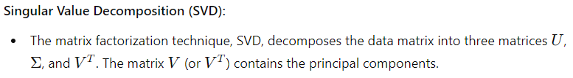
PCA: Principal Components
Key Takeaways:
PCA finds the directions (principal components) that capture the most variance in the data.
Projection onto these directions minimises information loss.
Orthogonal Axes: Each new principal component is orthogonal to the previous ones, capturing the remaining variance.
SVD is a standard method to find these components.
Notes:
https://www.linkedin.com/pulse/100-open-source-big-data-ml-architecture-papers-sequel-anil-madan

Slide 15
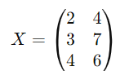
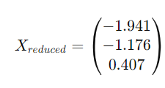
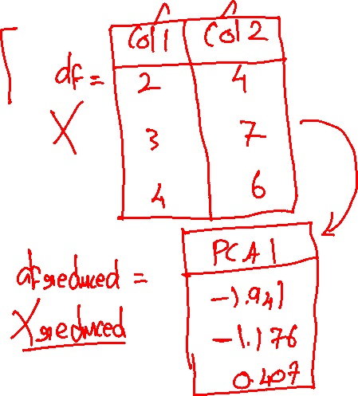
PCA: Calculation
Steps
Centering the Data:
Calculate the Covariance Matrix
Sort the Eigenvectors by Eigenvalues
Perform Eigen Decomposition
Project the Data onto the Principal Components:
Notes:
https://www.linkedin.com/pulse/100-open-source-big-data-ml-architecture-papers-sequel-anil-madan

Slide 16
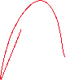





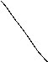
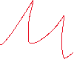










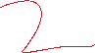
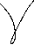




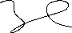
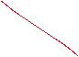

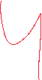

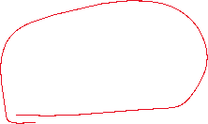
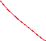






Slide 17



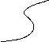
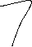


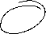

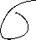


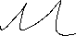


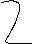




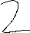







Slide 18






















Slide 19



































Slide 20
























Slide 21





















Slide 22













Slide 23





































Slide 24




































Slide 25





































Slide 26

















Slide 27






















Slide 28
















Slide 29























Slide 30


















Slide 31








































Slide 32


























Slide 33





















Slide 34




































Slide 35



Slide 36


PCA: Calculation
Steps
Centering the Data:
Notes:
https://www.linkedin.com/pulse/100-open-source-big-data-ml-architecture-papers-sequel-anil-madan

Slide 37




PCA: Calculation
Steps
Calculate the Covariance Matrix
Notes:
https://www.linkedin.com/pulse/100-open-source-big-data-ml-architecture-papers-sequel-anil-madan

Slide 38





PCA: Calculation
Steps
Perform Eigen Decomposition
Notes:
https://www.linkedin.com/pulse/100-open-source-big-data-ml-architecture-papers-sequel-anil-madan

Slide 39

PCA: Calculation
Steps
Perform Eigen Decomposition
Notes:
https://www.linkedin.com/pulse/100-open-source-big-data-ml-architecture-papers-sequel-anil-madan

Slide 40


Slide 41



Slide 42



Slide 43



Slide 44

PCA: Calculation
Steps
Sort the Eigenvectors by Eigenvalues
Notes:
https://www.linkedin.com/pulse/100-open-source-big-data-ml-architecture-papers-sequel-anil-madan

Slide 45




PCA: Calculation
Steps
Project the Data onto the Principal Components:
Notes:
https://www.linkedin.com/pulse/100-open-source-big-data-ml-architecture-papers-sequel-anil-madan

Slide 46








Eigen value calculation examples
Notes:
https://www.linkedin.com/pulse/100-open-source-big-data-ml-architecture-papers-sequel-anil-madan

Slide 47



Eigen value calculation examples
Notes:
https://www.linkedin.com/pulse/100-open-source-big-data-ml-architecture-papers-sequel-anil-madan

Slide 48
















Choosing the Right Number of Dimensions
1. Understanding the Explained Variance Plot (Figure 8-8):
What It Shows: The plot shows the cumulative explained variance as a function of the number of dimensions. As you increase the number of dimensions, the explained variance increases.
Elbow Method: The "elbow" in the curve is a point where adding more dimensions yields diminishing returns in terms of explained variance. This is often a good point to stop adding more dimensions.
Notes:
https://www.linkedin.com/pulse/100-open-source-big-data-ml-architecture-papers-sequel-anil-madan

Slide 49

Choosing the Right Number of Dimensions: Python example
This image represents a plot of explained variance versus the number of dimensions (or principal components) in a dataset after applying Principal Component Analysis (PCA).
Blue Line: Represents the cumulative explained variance as you add more dimensions.
Green Dashed Line: Marks the 95% variance threshold. It shows where you capture 95% of the data's variance.
Red Dashed Line: Indicates that with 10 dimensions, you capture nearly 100% of the variance.
Notes:
https://www.linkedin.com/pulse/100-open-source-big-data-ml-architecture-papers-sequel-anil-madan

Slide 50
Choosing the Right Number of Dimensions: Python example
Explained Variance: As you add more dimensions (moving to the right on the x-axis), the explained variance increases. Initially, adding dimensions significantly increases the variance captured, but after a certain point, adding more dimensions provides diminishing returns (the curve flattens out).
Dimensionality Reduction Decision: If your goal was to retain 95% of the variance, you could refer to the green dashed line. Since the curve nearly reaches this line by the 9th or 10th component, you would conclude that retaining around 9 or 10 dimensions is sufficient.
Choosing the Number of Components:
If you want to simplify your model without losing much information, you might choose the number of dimensions where the blue curve crosses the 95% variance line (green dashed line).
In this specific case, all 10 dimensions are needed to capture nearly 100% of the variance, so reducing dimensions might not be necessary unless you're specifically looking to simplify the model.
Notes:
https://www.linkedin.com/pulse/100-open-source-big-data-ml-architecture-papers-sequel-anil-madan

Slide 51
PCA
Incremental PCA
Handles Big Data: Processes massive datasets efficiently in smaller batches.
Adapts to Streams: Updates model with incoming data, ideal for real-time analysis.
Memory-Friendly: Reduces computational burden, perfect for limited resources.
Randomized PCA
Fast Computation: Speedy approximation for high-dimensional data.
Scales Well: Efficiently handles datasets with numerous features.
Speed Over Precision: Trades some accuracy for faster results.
Kernel PCA
Nonlinear Relationships: Captures complex patterns in data.
Kernel Trick: Computes in higher dimensions without transforming data.
Flexible: Adapts to various non-linear structures using different kernels.
Choose Wisely: Select the right technique based on your data size, dimensionality, and the type of relationships you seek to uncover.
Notes:
https://www.linkedin.com/pulse/100-open-source-big-data-ml-architecture-papers-sequel-anil-madan

Slide 52



Other dimensionality reduction techniques
Unrolled Swiss Roll (Figure 8-12):
What It Shows: The figure illustrates the result of applying Locally Linear Embedding (LLE) to a 3D Swiss roll dataset, reducing it to 2D. The original Swiss roll shape, which is a twisted manifold in 3D space, is "unrolled" into a 2D plane.
Interpretation: In this 2D representation, the algorithm preserves local relationships, meaning nearby points in the original 3D space remain close in the 2D projection. However, larger-scale distances might be distorted (e.g., one side is stretched while the other is compressed).
Notes:
https://www.linkedin.com/pulse/100-open-source-big-data-ml-architecture-papers-sequel-anil-madan

Slide 53
Other dimensionality reduction techniques
LLE Step One (Equation 8-4):
Objective: This equation describes the first step of LLE, where the algorithm models the local linear relationships between each point and its neighbors.
Mathematical Details:
WWW is the weight matrix that we want to optimize.
The goal is to minimize the difference between each point x^{(i)}and a weighted sum of its k nearest neighbors x^{(j)}.
The constraints ensure that weights are non-zero only for the k nearest neighbors and that the weights for each point sum to 1.
Notes:
https://www.linkedin.com/pulse/100-open-source-big-data-ml-architecture-papers-sequel-anil-madan

Slide 54





Other dimensionality reduction techniques
LLE Step Two (Equation 8-5):
Objective: This equation describes the second step of LLE, where the algorithm reduces dimensionality while preserving the relationships modelled in the first step.
Mathematical Details:
Z represents the low-dimensional representation of the original points.
The goal is to find the positions z^{(i)} in the reduced space such that the local relationships (encoded by the weight matrix W) are preserved as much as possible.
Notes:
https://www.linkedin.com/pulse/100-open-source-big-data-ml-architecture-papers-sequel-anil-madan

Slide 55

Other dimensionality reduction techniques
3. t-Distributed Stochastic Neighbor Embedding (t-SNE):
Method: t-SNE focuses on keeping similar instances close and dissimilar instances far apart. It is mainly used for visualizing high-dimensional data.
Result (Right Plot): t-SNE produces clusters in the 2D space, separating different parts of the Swiss roll. This is useful for visualizing clusters or groups within the data but may distort distances on a larger scale.
1. Multidimensional Scaling (MDS):
Method: MDS reduces dimensionality while attempting to preserve the distances between instances.
Result (Left Plot): The Swiss roll is unraveled into a circular pattern. This shows that MDS is effective at preserving distances, as the structure is kept in a similar form but spread out into 2D.
2. Isomap:
Method: Isomap constructs a graph by connecting each instance to its nearest neighbors and then reduces dimensionality while preserving the geodesic (shortest path) distances between instances.
Result (Middle Plot): The Swiss roll is unwrapped into a linear form, showing that Isomap is particularly good at preserving the manifold’s intrinsic geometry, making the structure more linear in 2D.
Notes:
https://www.linkedin.com/pulse/100-open-source-big-data-ml-architecture-papers-sequel-anil-madan

Slide 56
Other dimensionality reduction techniques
Summary of Techniques:
MDS: Preserves distances and gives a circular pattern in 2D.
Isomap: Preserves the manifold structure, resulting in a linear unrolling.
t-SNE: Focuses on local relationships, producing clusters but potentially distorting larger-scale distances.
Each method has different strengths and is suitable for different types of data and objectives, particularly in how they handle the preservation of distances and relationships when reducing dimensions.
Notes:
https://www.linkedin.com/pulse/100-open-source-big-data-ml-architecture-papers-sequel-anil-madan

Slide 57

Anomaly Detection
1. Anomaly Detection Using a Gaussian Mixture Model (Figure 9-19):
Explanation: The image shows the use of a GMM for detecting anomalies (outliers) in a dataset. The GMM models the data as a mixture of multiple Gaussian distributions, represented by the contours. Data points in regions of low density (fewer points and lighter contours) are flagged as anomalies (shown as red stars).
Practical Use: You can set a density threshold (e.g., the 4th percentile) to detect anomalies. Adjusting this threshold changes the trade-off between false positives and false negatives.
Notes:
https://www.linkedin.com/pulse/100-open-source-big-data-ml-architecture-papers-sequel-anil-madan

Slide 58
















Anomaly Detection
2. Bayesian Information Criterion (BIC) and Akaike Information Criterion (AIC) (Equation 9-1):
Explanation: BIC and AIC are criteria used to evaluate models and select the best one by balancing goodness of fit and model complexity.
BIC: Penalizes models with more parameters and rewards those that fit the data well, with a tendency to favor simpler models.
AIC: Also penalizes complexity but is generally less strict than BIC, potentially favoring models that fit the data better at the cost of complexity.
Purpose: These criteria help in choosing the optimal number of clusters in a GMM or selecting other model parameters.
Notes:
https://www.linkedin.com/pulse/100-open-source-big-data-ml-architecture-papers-sequel-anil-madan

Slide 59

Anomaly Detection
Likelihood Function and Maximum Likelihood Estimation (Figure 9-20):
Explanation:
Likelihood Function: The likelihood of a set of parameter values given the observed data. It shows how likely a particular model is to explain the observed data.
Maximum Likelihood Estimation (MLE): Finds the parameter values that maximize this likelihood, making the model best fit the data.
Log-Likelihood: Maximizing the log of the likelihood function is mathematically simpler and equivalent to maximizing the likelihood itself.
Practical Use: MLE is used to estimate the parameters of a GMM or any statistical model, helping to ensure the model best represents the data.
Notes:
https://www.linkedin.com/pulse/100-open-source-big-data-ml-architecture-papers-sequel-anil-madan

Slide 60

Anomaly Detection
Model Selection with BIC and AIC (Figure 9-21):
Explanation: The graph shows the BIC and AIC values for different numbers of clusters kkk in a GMM. The lowest point on these curves indicates the optimal number of clusters.
Result: In this example, both BIC and AIC suggest that 3 clusters are the best choice, as they minimize the information criteria.
Notes:
https://www.linkedin.com/pulse/100-open-source-big-data-ml-architecture-papers-sequel-anil-madan

Slide 61
Anomaly Detection
Summary:
GMMs and Anomaly Detection: Gaussian Mixture Models can be used to detect anomalies by identifying points in low-density regions.
BIC and AIC for Model Selection: These criteria help choose the best model by balancing fit and complexity, commonly used for selecting the number of clusters in GMMs.
MLE and Likelihood: The likelihood function is crucial for estimating the best-fitting model parameters, with MLE being a key technique.
Notes:
https://www.linkedin.com/pulse/100-open-source-big-data-ml-architecture-papers-sequel-anil-madan

Slide 62

Anomaly Detection
1. Bayesian Gaussian Mixture Model (Figure 9-22):
Explanation: This diagram illustrates the components of a Bayesian Gaussian Mixture Model. Unlike a regular GMM, the parameters (weights, means, and covariance matrices) are treated as random variables.
The model includes prior distributions like the Beta distribution for weights and the Wishart distribution for covariance matrices.
This structure allows the model to adjust the number of clusters automatically based on the data.
Notes:
https://www.linkedin.com/pulse/100-open-source-big-data-ml-architecture-papers-sequel-anil-madan

Slide 63

Anomaly Detection
Effect of Concentration Prior on Clustering (Figure 9-23):
Explanation: The two plots show how different settings of the weight_concentration_prior affect the number of clusters detected by the BGMM.
Low Prior (0.01): Leads to fewer clusters as it favors fewer, larger clusters.
High Prior (10,000): Encourages the model to identify more clusters, potentially splitting data into more fine-grained groups.
Notes:
https://www.linkedin.com/pulse/100-open-source-big-data-ml-architecture-papers-sequel-anil-madan

Slide 64



Anomaly Detection
Notes:
https://www.linkedin.com/pulse/100-open-source-big-data-ml-architecture-papers-sequel-anil-madan

Slide 65

Anomaly Detection
5. Non-Ellipsoidal Clusters (Figure 9-24):
Explanation: The left plot shows the original dataset with non-ellipsoidal clusters (a moons dataset). The right plot illustrates how the BGMM tries to fit this data but struggles because it assumes clusters are ellipsoidal. It incorrectly finds multiple clusters instead of just two, showing the limitations of BGMMs with non-ellipsoidal data.
Notes:
https://www.linkedin.com/pulse/100-open-source-big-data-ml-architecture-papers-sequel-anil-madan

Slide 66
Anomaly Detection
Summary:
BGMMs: Useful for automatically determining the number of clusters and handling uncertainty in model parameters.
Concentration Prior: Adjusts how the model splits the data into clusters.
Bayes’ Theorem: Central to updating the model based on observed data.
Limitations: BGMMs work well for ellipsoidal clusters but may fail with more complex shapes, requiring alternative clustering methods.
Notes:
https://www.linkedin.com/pulse/100-open-source-big-data-ml-architecture-papers-sequel-anil-madan

Slide 67
Anomaly Detection
Here's a summary of various algorithms for anomaly and novelty detection as implemented in Scikit-Learn:
1. PCA (Principal Component Analysis):
Use Case: Anomaly detection by comparing reconstruction errors.
How It Works: Anomalies typically have larger reconstruction errors compared to normal instances when you try to reconstruct them after dimensionality reduction.
2. Fast-MCD (Minimum Covariance Determinant):
Implemented By: EllipticEnvelope class.
Use Case: Outlier detection.
How It Works: Estimates a Gaussian distribution around the inliers while ignoring potential outliers, providing a better fit for identifying anomalies.
Notes:
https://www.linkedin.com/pulse/100-open-source-big-data-ml-architecture-papers-sequel-anil-madan

Slide 68
Anomaly Detection
3. Isolation Forest:
Use Case: Outlier detection in high-dimensional datasets.
How It Works: Randomly partitions the data using decision trees. Anomalies, being isolated from others, tend to be separated in fewer steps, making them easier to detect.
4. Local Outlier Factor (LOF):
Use Case: Outlier detection.
How It Works: Compares the density around an instance to the density around its neighbors. Anomalies are typically less dense and more isolated compared to their neighbors.
5. One-Class SVM:
Use Case: Novelty detection.
How It Works: Separates normal instances from the origin in a high-dimensional space. Instances outside the defined region are considered anomalies.
Notes:
https://www.linkedin.com/pulse/100-open-source-big-data-ml-architecture-papers-sequel-anil-madan

Slide 69
Anomaly Detection
Summary:
PCA: Effective for detecting anomalies through reconstruction errors.
EllipticEnvelope (Fast-MCD): Best for datasets assumed to have a single Gaussian distribution of inliers.
Isolation Forest: Efficient for high-dimensional outlier detection by isolating instances.
LOF: Detects anomalies based on local density comparison with neighbors.
One-Class SVM: Suited for novelty detection by defining a boundary that separates known instances from potential outliers.
These algorithms offer a variety of approaches for detecting anomalies or novelties, depending on the nature of your data and the specific needs of your analysis.
Notes:
https://www.linkedin.com/pulse/100-open-source-big-data-ml-architecture-papers-sequel-anil-madan

Slide 70
Anomaly Detection
Notes:
https://www.linkedin.com/pulse/100-open-source-big-data-ml-architecture-papers-sequel-anil-madan

